Slide 1



Student Course Management System
Welcome to the Student Course Management System, a text-based application developed in C++ to efficiently handle student enrollments and course registrations. This system utilizes fundamental data structures such as linked lists and queues to manage course and student information. The project aims to provide a user-friendly interface for registering students, managing courses, and handling enrollment processes.

Slide 2
System Requirements
1
Register Students and Courses
2
Enrollment Management
Allow users to register new students and courses, with courses having a limited number of slots available.
Enable student enrollment in courses if slots are available, otherwise add them to a waiting list.
3
De-enrollment Process
4
Information Display
Provide functionality to de-enroll students, automatically enrolling the first student from the waiting list if applicable.
Allow users to view available courses and registered students' information.

Slide 3
System Design: Use Cases
Use Case
Purpose
Register a student
Register new student name
Register a course
Register new course
Enrol a student in a course
Enrol student in a course subject
De-enrol a student from a course
Remove a student from enrollment in a course
Display available courses
Check the courses that are available
Display registered students
Check the registered students' information

Slide 4

System Design: Flow Charts
1
Student Course Management System
Overview of the entire system flow
2
Register a Student
Process for adding new students to the system
3
Register a Course
Steps for creating new courses
4
Enrol a Student in a Course
Procedure for course enrollment
5
De-enrol a Student from a Course
Process for removing students from courses
6
Display Available Courses
Method for showing course availability
7
Display Registered Students
Procedure for viewing student information

Slide 5
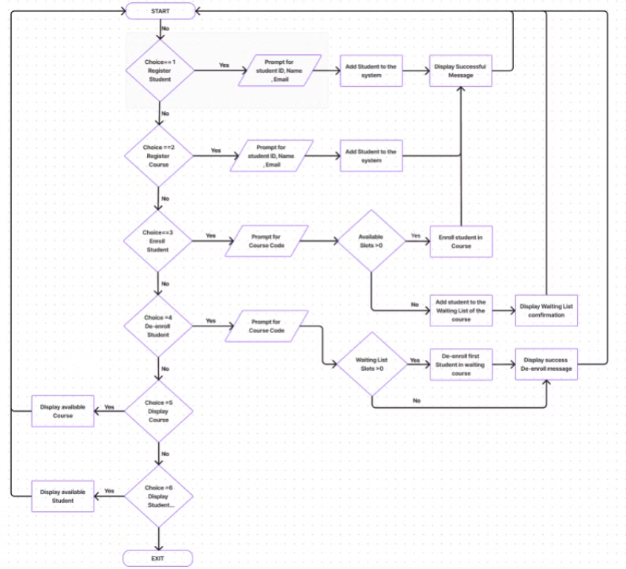
System Design: Flow Charts

Slide 6
System Prototype: User Interface
Main Menu
Registration Screens
Enrollment Management
Displays options 1-6 for different functionalities. Users must enter a valid integer to proceed.
Separate interfaces for registering students (ID, email, name) and courses (name, code, slots, credit hours).
Screens for enrolling/de-enrolling students, displaying course lists, and managing waitlists.

Slide 7
Data Structures: UML Diagram
Course and Student Classes
Node Classes
Represent individual courses and students with attributes like name, code, and email.
CourseNode and StudentNode facilitate linked list implementation for courses and students.
List Classes
CourseList and StudentList manage collections of courses and students using linked list structure.

Slide 8
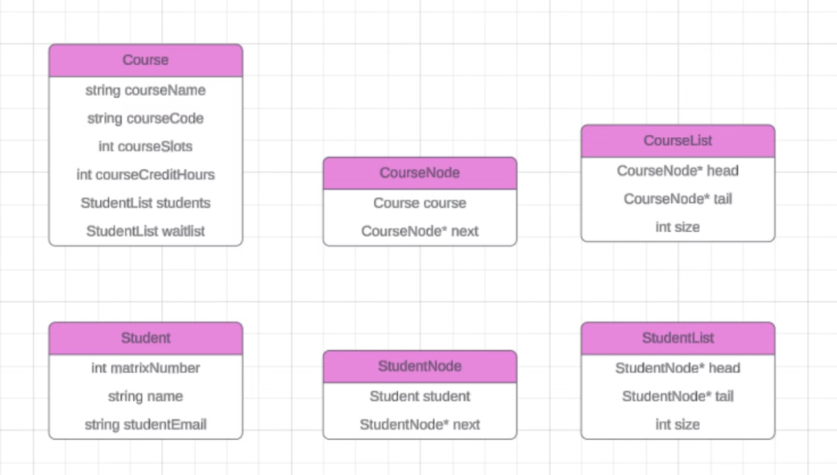
Data Structures: UML Diagram

Slide 9


Implementation: Linked Lists and Queues
Student List
Course List
Implemented as a linked list for efficient management of student records.
Uses linked list structure to organize and manage course information.

Slide 10
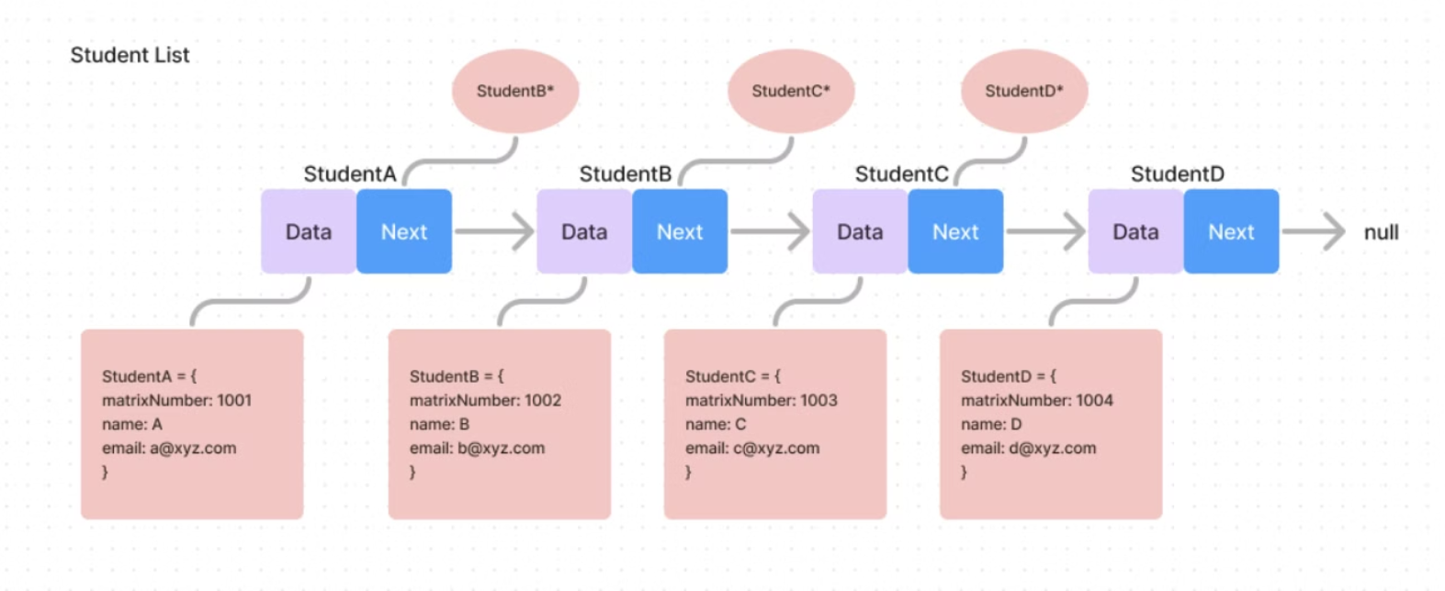
Implementation: Linked Lists and Queues

Slide 11
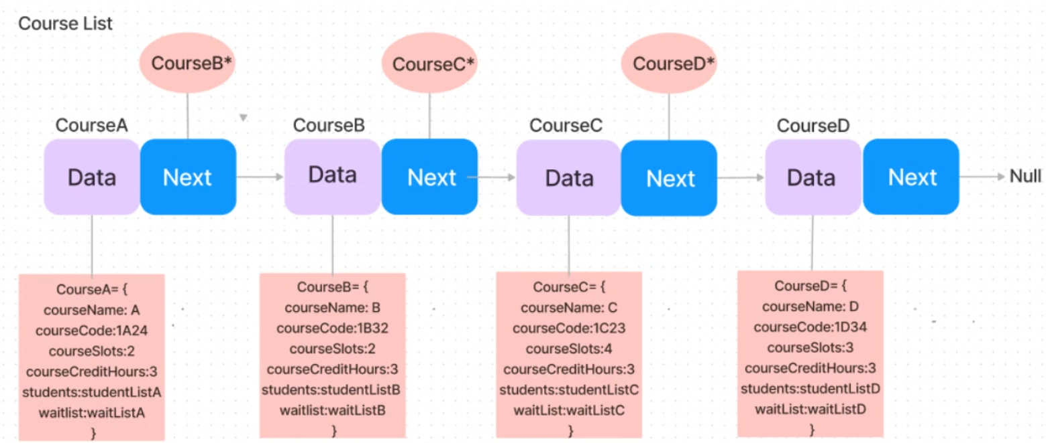
Implementation: Linked Lists and Queues

Slide 12

Conclusion and Future Enhancements
The Student Course Management System provides a robust foundation for managing student enrollments and course registrations. By utilizing linked lists and queues, the system offers efficient data management and processing. Future enhancements could include a graphical user interface, database integration for persistent storage, and advanced reporting features to provide deeper insights into student enrollment patterns and course popularity.

